Slide 1


Self-introduction
CST1909129 Chen Yiyang

Slide 2
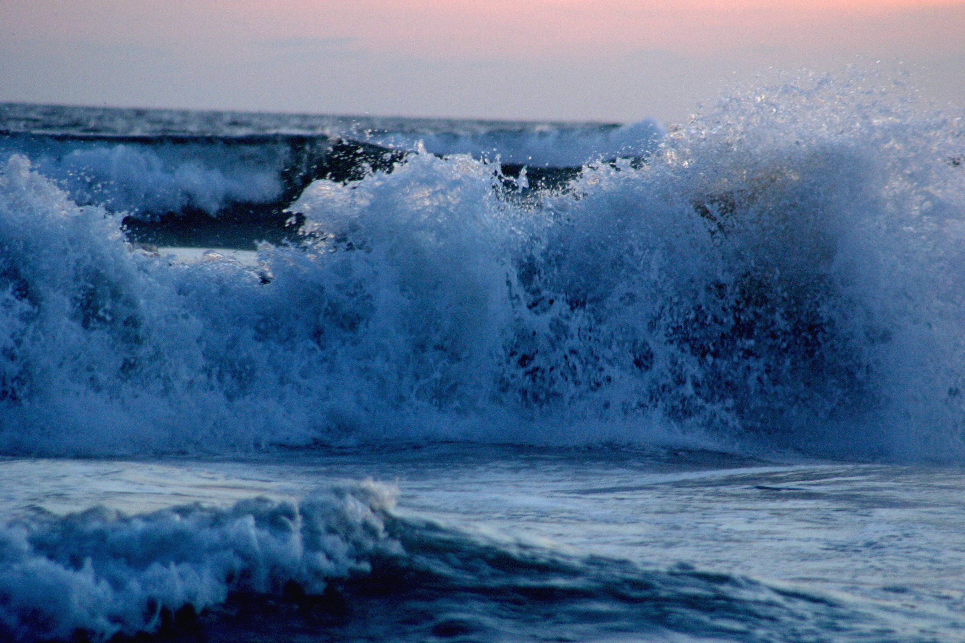
Hello everyone, my name is Chen Yiyang. I am from Xiamen,which is a coastal city.

Slide 3
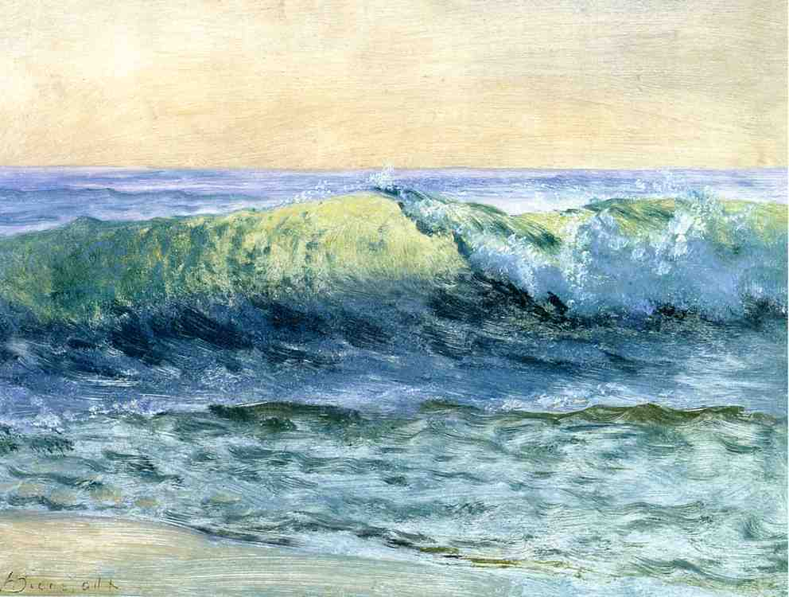
I like reading books and watching movies in my spare time,for they can give me a lot of fun.I am also keen on traveling,because it gives me a chance to get out of the small box of my life and see how other people live.

Slide 4
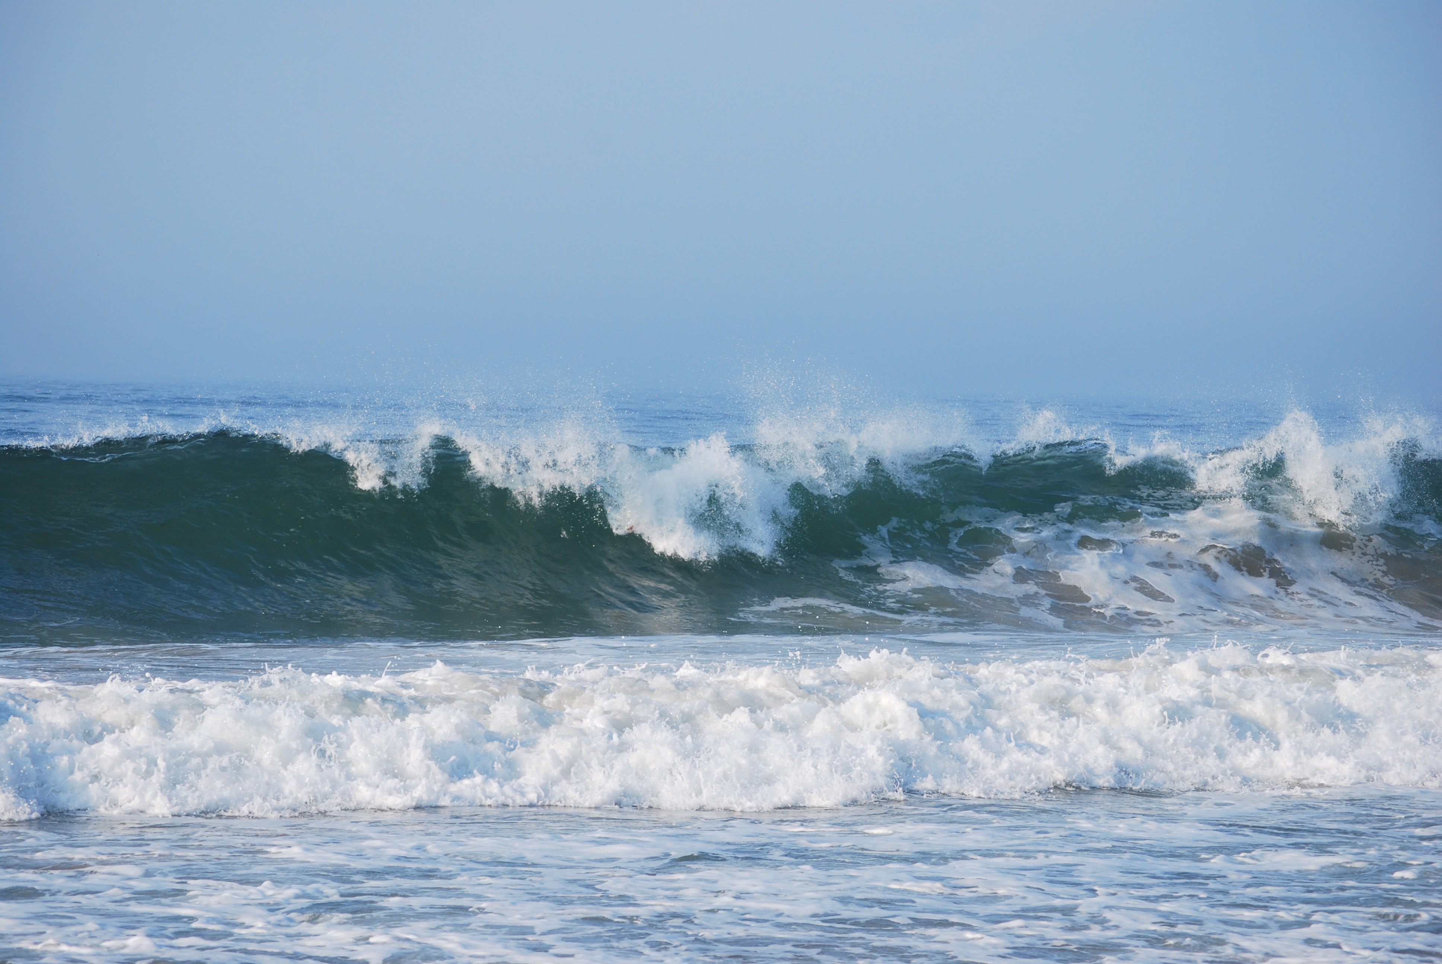
Although I have never been a tech savvy.But I still want to explore in this unknown field and enjoy the fun of this subject.I believe I can do a good job. Thank you for your watching.☺

